Slide 1
Resume Classification
Mentor : Mr. Karthik Muskula
-:Presented by:-
Group No.: 02
Ms. Sana Sultana
Mr. Chinmay Milind Nikumbh
Mr. Amol Shalikram Dongare
Ms. Sweety Rajendra Nandurkar
Mr. PUGALENDHI S
Mr. Rajesh Kumar Sethi
Mr. Rohit Sanjay Gadekar

Slide 2
Content
Business Objective
Data Summary
Feature Extraction
EDA
Model Building
Deployment
Final Presentation

Slide 3
Business Objective
The document classification solution should significantly reduce the manual human effort in the HRM. It should achieve a higher level of accuracy and automation with minimal human intervention
Data summary
Resume Dataset:
It contains Resume folders in doc file, pdf file and docx file :
People soft Resumes
SQL Developer Lightning insight
workday resumes
React JS

Slide 4
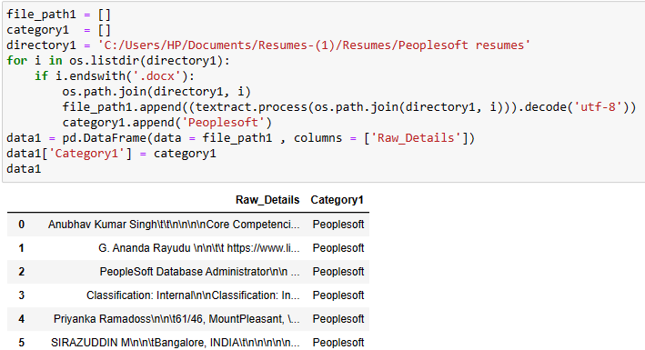
Importing Files
Importing Extracted text from all the Resume files

Slide 5
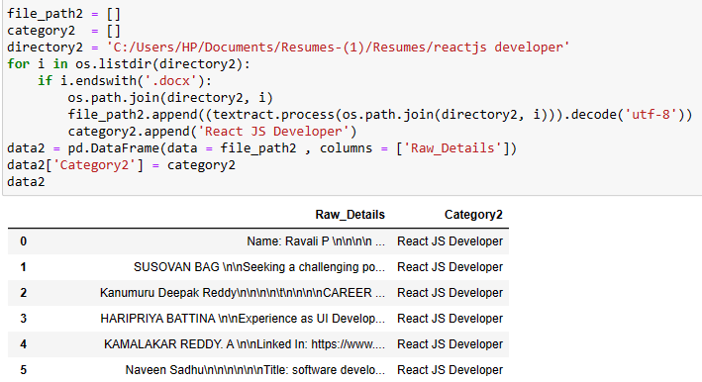
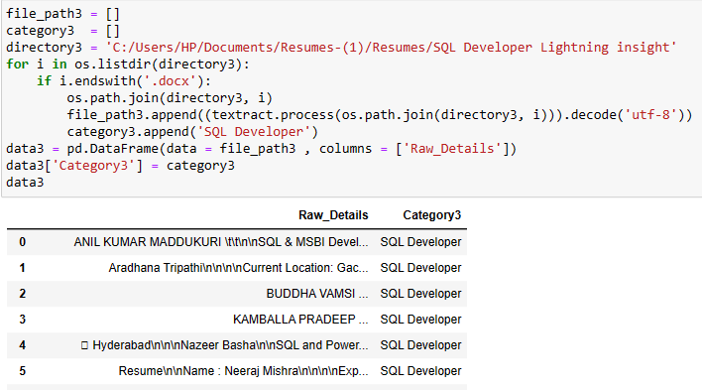

Slide 6
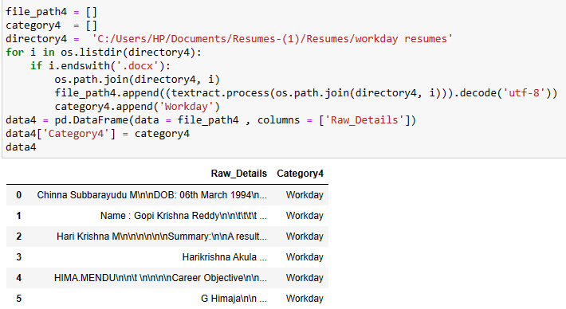

Slide 7
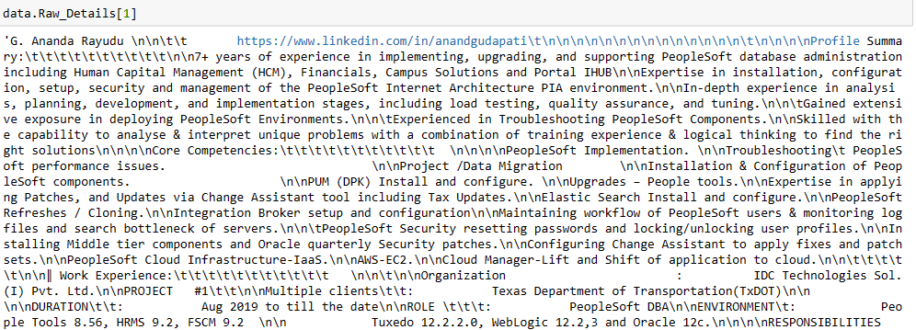
Extracted Text

Slide 8
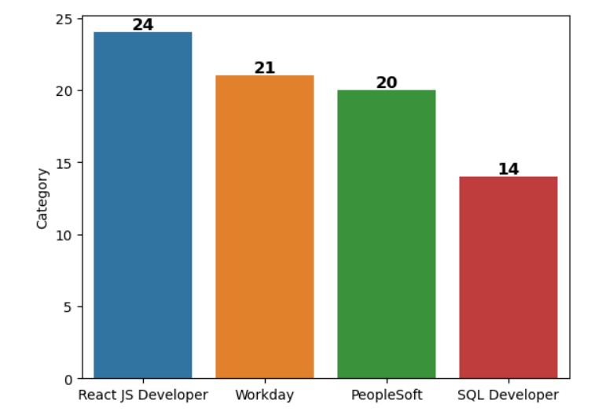
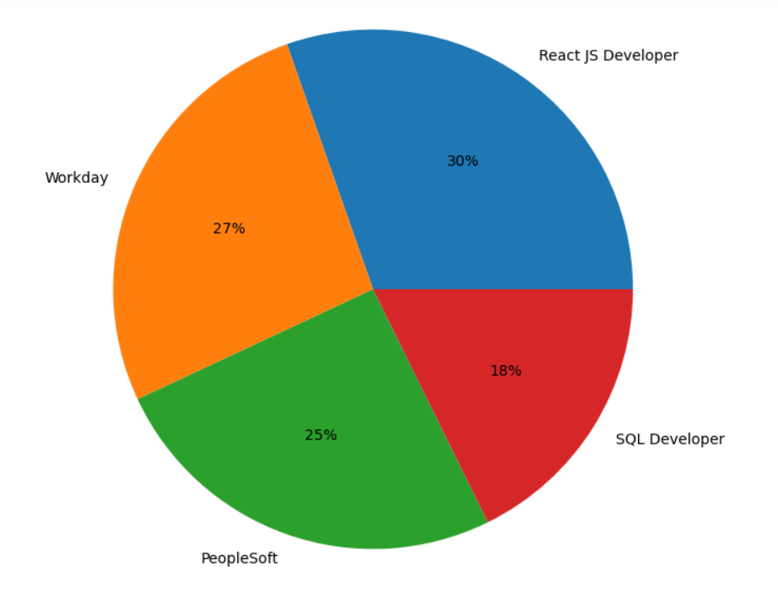
Number and percentage of different category resume files

Slide 9
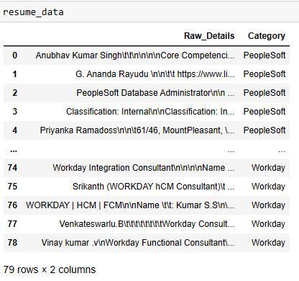
Append all data together and combine all resume category

Slide 10

Resume Data Shape
Exploratory Data Analysis(EDA)
Extraction of text using textract module
from all the resume files and also
distributing them into four different
categories.
Resume data converted to csv file

Slide 11
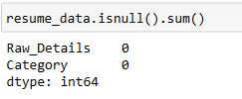
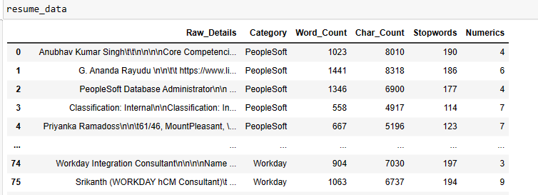
Checking Null Values
Checking word count, char_count, stopwords, numerics

Slide 12
Data Preprocessing
Converting the text into string format.
Convert the characters into lower case.
Replace all html tags into blank space.
Replace punctuations into blank space.
Substitute http tags into blank space.
Substitute all numbers into blank space.
Use RegexpTokenizer to tokenize the text into words. It works by compiling our pattern, then calling re.findall()on our text. We could utilize this function to match alphanumeric tokens plus single quotes.
Remove the stopwords.

Slide 13
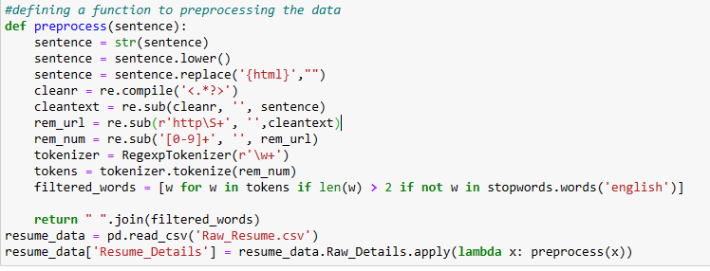
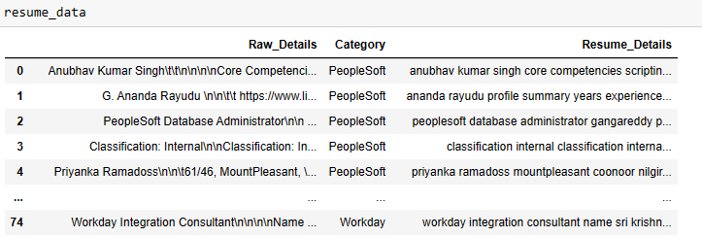
Defining a function to preprocessing the data

Slide 14
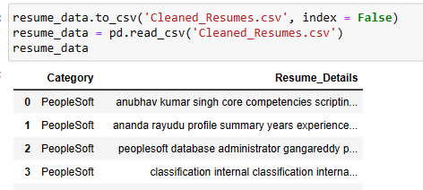
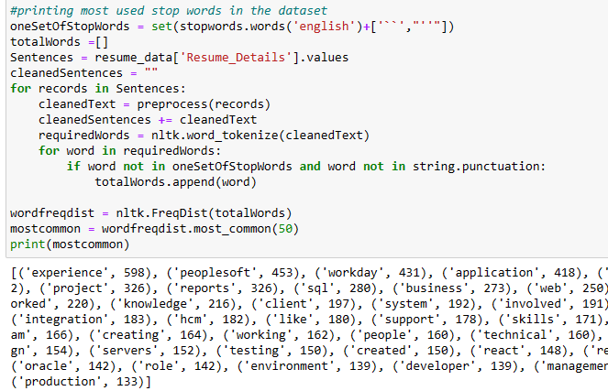
Resume data converting to a csv file named cleaned data
Checking Stopwords

Slide 15
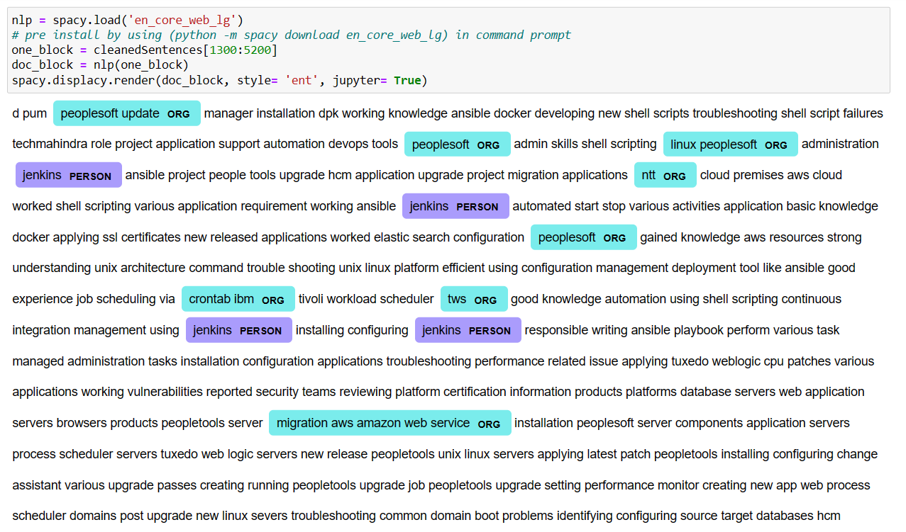
Named Entity Recognition
NER involves detecting and categorizing important information in text known as named entities.
An entity is basically the thing that is consistently talked about or refer to in the text.
Some of the categories that are the most important architecture in NER such that:
Person
Organization
Place/ location
We use spacy module for NER

Slide 16
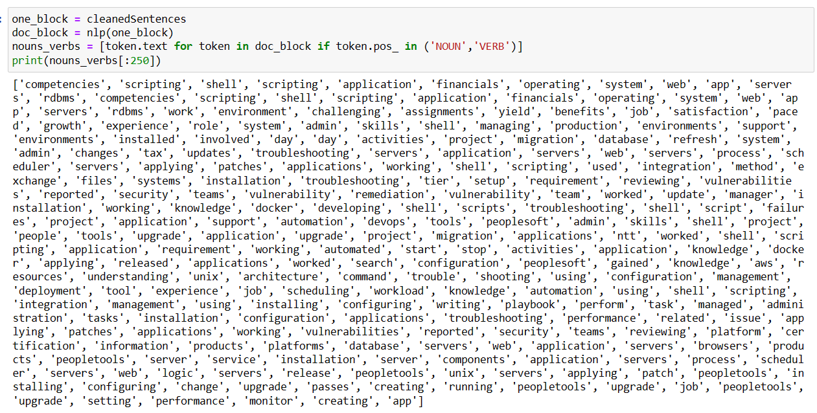
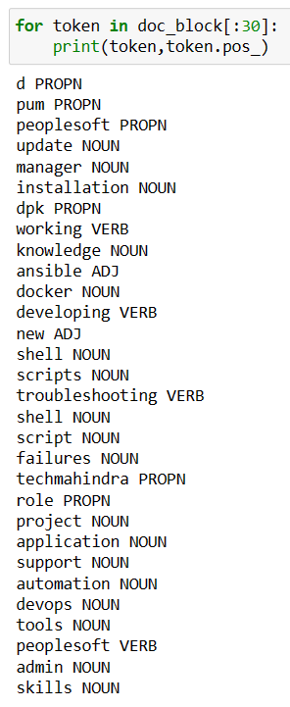
PARTS OF SPEECH(POS) RECOGNITION
POS tagging is a process in natural language processing (NLP) where each word in a text is labeled with its corresponding part of speech.
This can include nouns, verbs, adjectives, and other grammatical categories.
Basically we are interested in only Nouns and Verbs
So we separate the words which are Nouns and Verbs with the help of token.pos_ tag which is used from spacy module

Slide 17
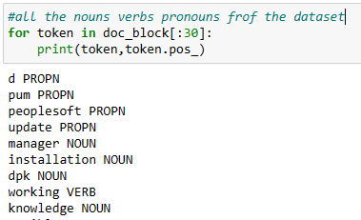
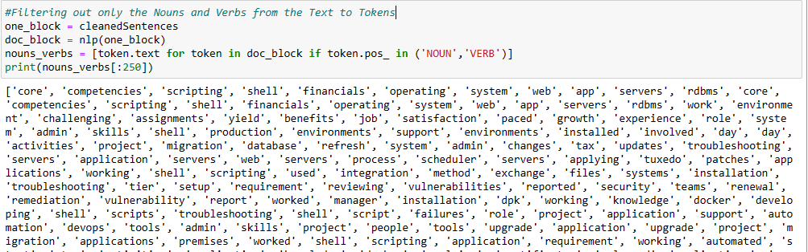
The nouns verbs pronouns from the dataset
Filtering out only the Nouns and Verbs from the Text to Tokens

Slide 18
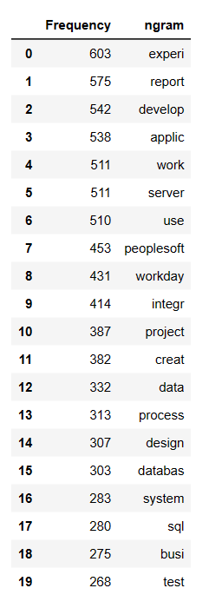
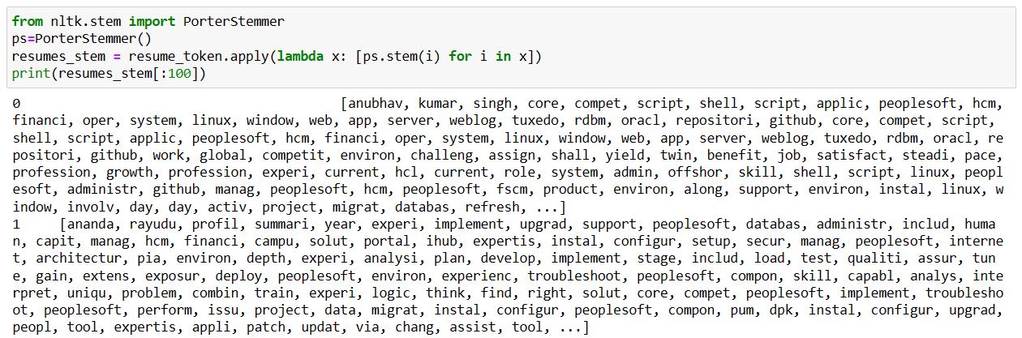
Stemming
Stemming is a natural language processing technique that is used to reduce words to their base form, also known as the root form.
The Porter stemmer is the most widely used algorithm, and it is based on a set of heuristics that are used to remove common suffixes from words.
Some disadvantages of stemming are: It can lead to a loss of information and make it more difficult to analyze text. For example, the word “experience” and “application” may be stemmed to “experi" and "applic" which does not convey the meaning of the original words.
So we move on to Lemmatization which is better than stemming and it also conveys the context of the word.

Slide 19
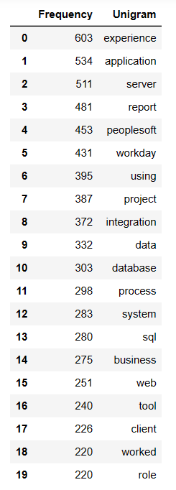
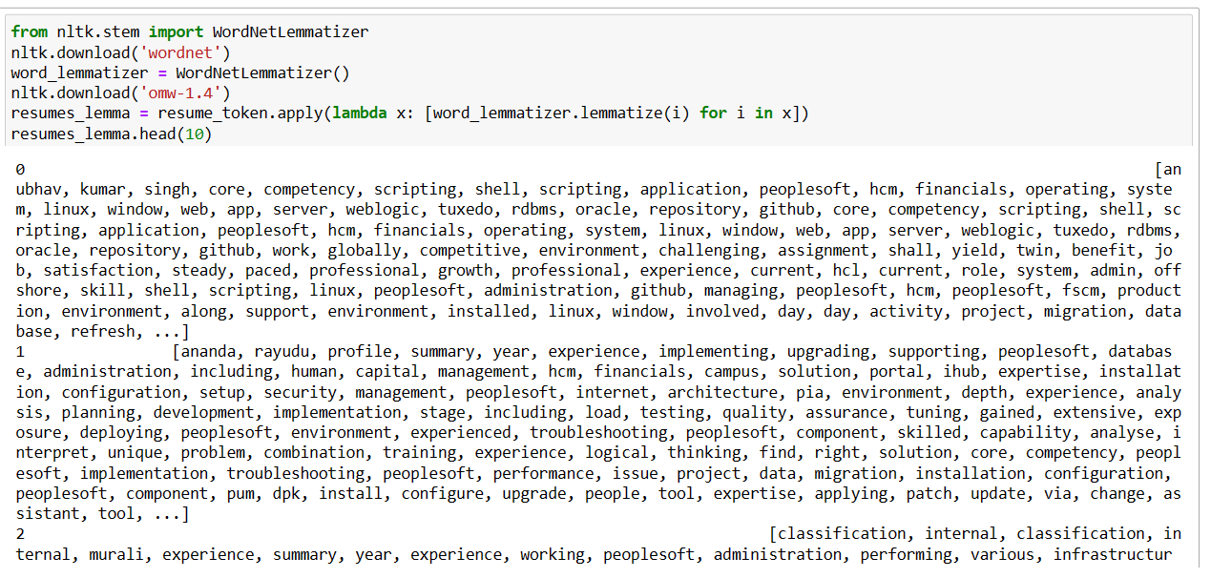
Lemmatization
Lemmatization is the process of grouping together the different inflected forms of a word so they can be analyzed as a single item.
Lemmatization is similar to stemming but it brings context to the words. So it links words with similar meanings to one word.
One of its modules is the WordNet Lemmatizer
Advantages of Lemmatization with NLTK:
Improves text analysis accuracy.
Reduces data size
Better search results
Useful for feature extraction

Slide 20
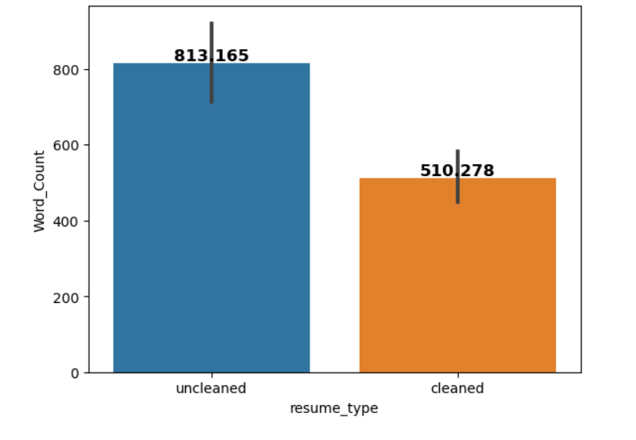
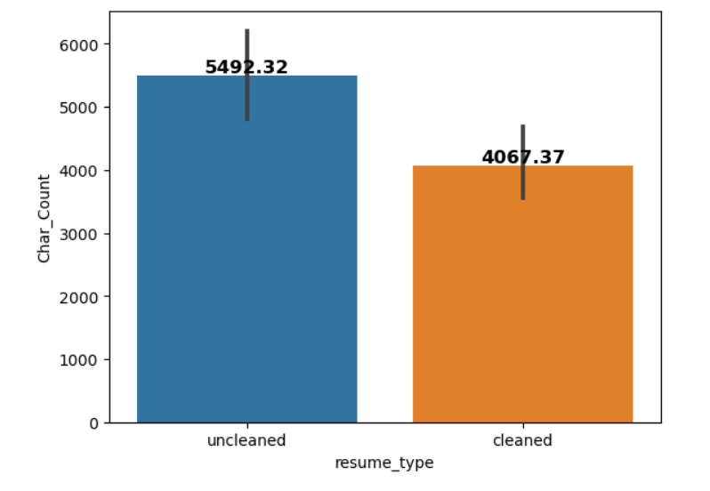
NUMBER OF WORDS AND CHARACTERS BEFORE AND AFTER CLEANING
Around 300 words were removed
Around 1450 characters were removed

Slide 21
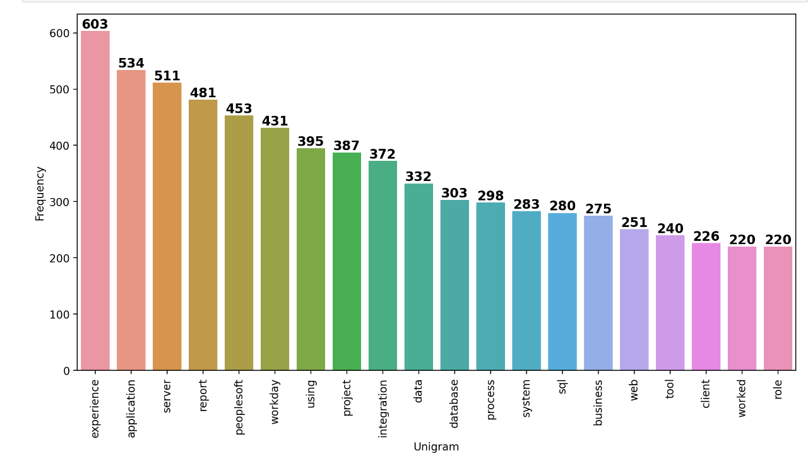
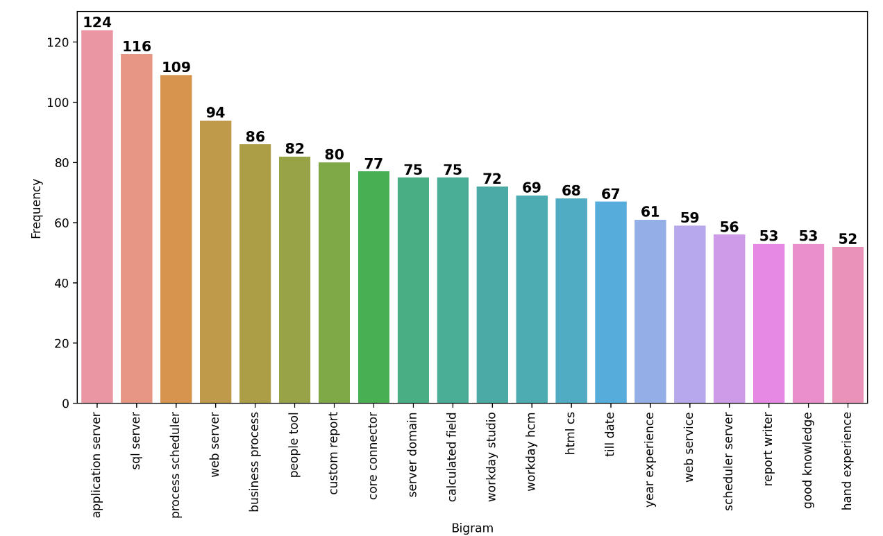
Creating n-grams using Count Vectorizer
UNIGRAM
BIGRAM

Slide 22
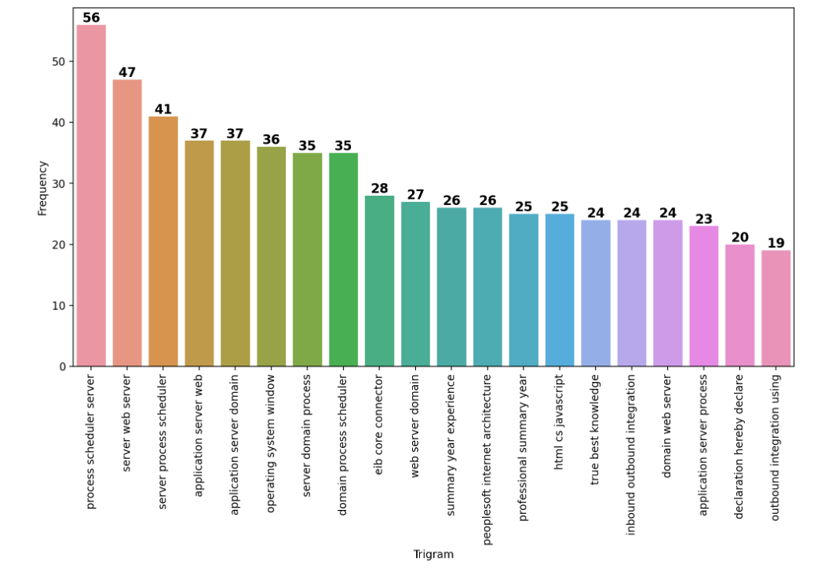
Creating n-grams using Count Vectorizer
TRIGRAM
CountVectorizer is a great tool provided by the sklearn library in Python.
It is used to transform a given text into a vector on the basis of the frequency (count) of each word that occurs in the entire text.
We can create n-grams using count vectorizer
Here we focus on only three types:
Unigram – frequency of only single words.
Bigram – frequency of double words.
Trigram - frequency of triple words.

Slide 23
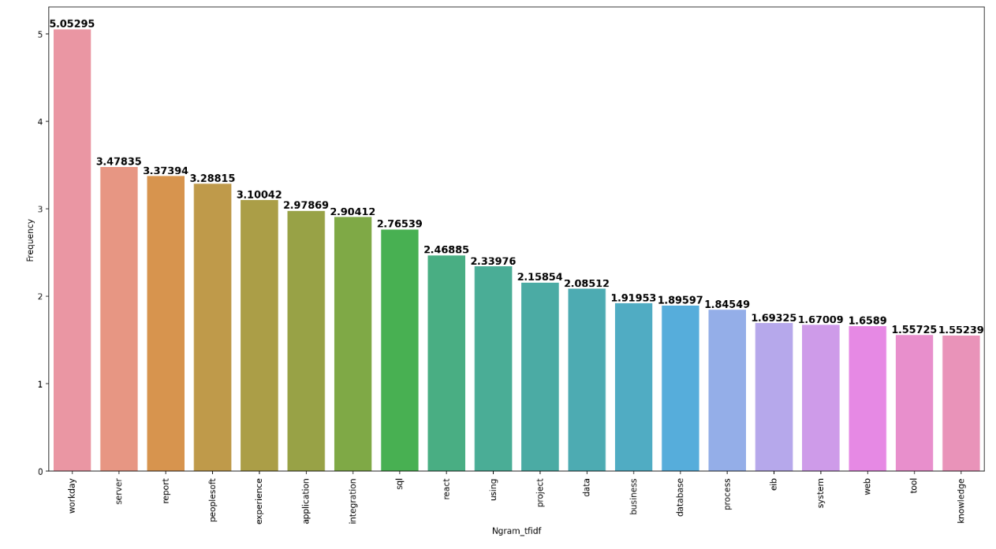
Creating n-grams using TF-IDF Vectorizer
TF-IDF stands for Term Frequency Inverse Document Frequency of records.
It can be defined as the calculation of how relevant a word in a series or corpus is to a text. The meaning increases proportionally to the number of times in the text a word appears but is compensated by the word frequency in the corpus

Slide 24
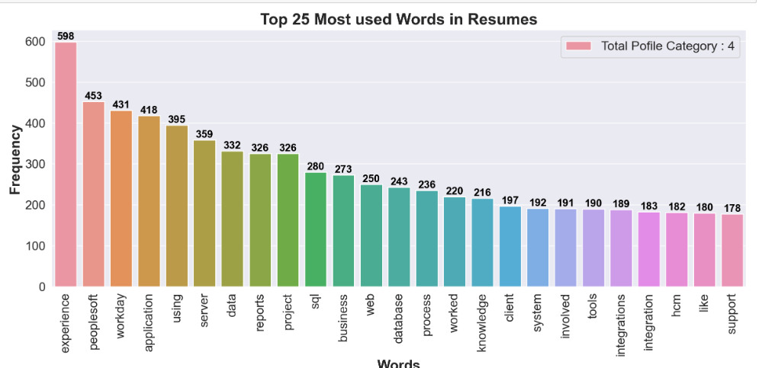
Most common words used in Resume

Slide 25
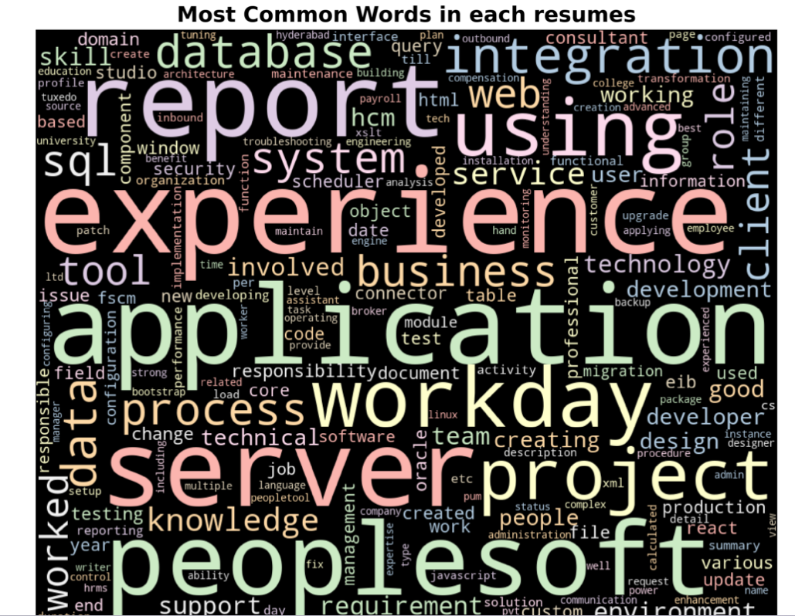
WORD CLOUD

Slide 26
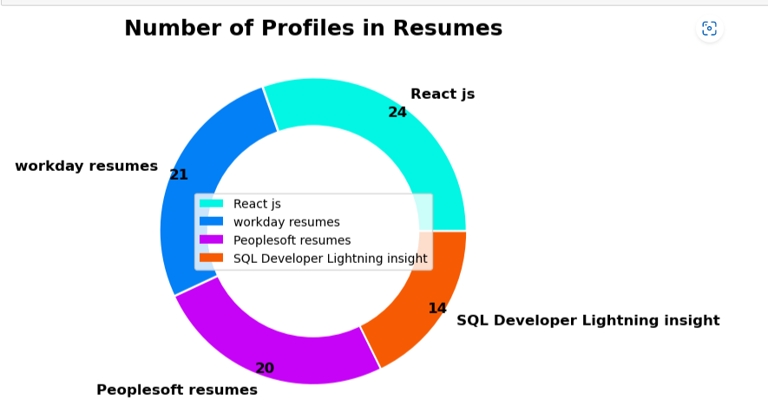
Checking Number of profiles in Resume

Slide 27
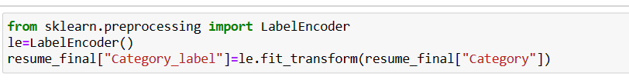
LABEL ENCODING
Category is encoded using Label Encoder.
There are four types of category
0 --> Peoplesoft resumes
1 --> ReactJS resumes
2 --> SQL Developer resumes
3 --> Workday resumes

Slide 28
MODEL BUILDING
WE USE DIFFERENT SUPERVISED LEARNING TECHNIQUES FOR MODEL BUILDING
LOGISTIC REGRESSION
NAÏVE BAYES
SUPPORT VECTOR MACHINES (SVM).
RANDOM FOREST
ADABOOST TECHNIQUE
GRADIENT BOOSTING
XG BOOSTING
WE USE TFIDF VECTORIZER TO CONVERT INPUT DATA(TEXT) INTO VECTORS OF REAL NUMBERS.
IN EACH OF THE ABOVE TECHNIQUES WE USE TRAIN-TEST SPLIT.
OUR MODEL WILL BE WELL TRAINED ON TRAINING DATASET AND WE PREDICT THE RESULT USING TEST DATASET.

Slide 29
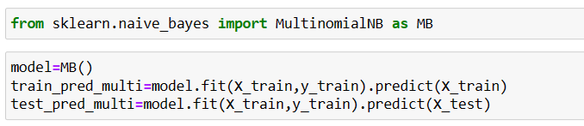
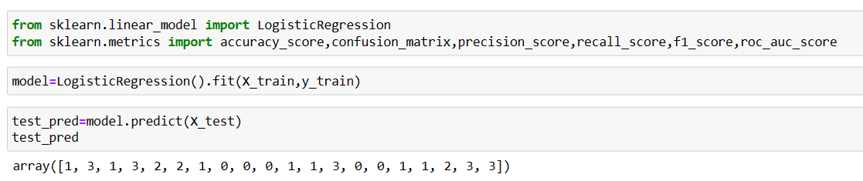
LOGISTIC REGRESSION
NAÏVE BAYES
Naïve Bayes is based on Bayes theorem with the "naïve" assumption of conditional independence between every pair of features given the value of class variable.
Logistic regression estimates the probability of an event occurring, such as voted or didn't vote, based on a given dataset of independent variables.
Logistic Regression is used when the dependent variable(target) is categorical.

Slide 30
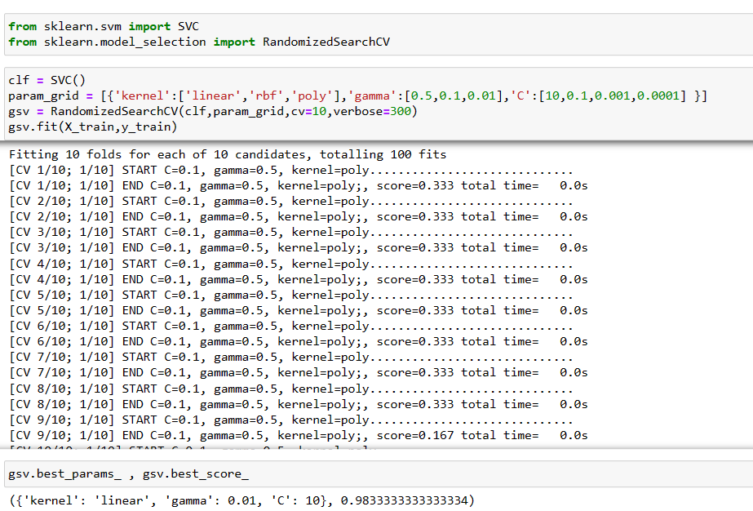
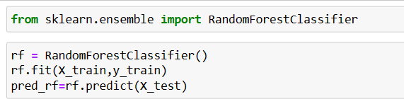
SUPPORT VECTOR MACHINES(SVM)
RANDOM FOREST
Random forest combines the output of multiple decision trees to reach a single result.
By combining the outputs of these trees, the random forest algorithm delivers a consolidated and more accurate result.
The main objective of the SVM algorithm is to find the optimal hyperplane in an N-dimensional space that can separate the data points in different classes in the feature space.
Different kernels in SVM are :- ‘linear’, ‘poly’, ‘rbf’, ‘sigmoid’
C is a Regularization parameter and gamma is a kernel coefficient
We use Randomized search to get the best parameters (kernel,C,gamma) and best score

Slide 31
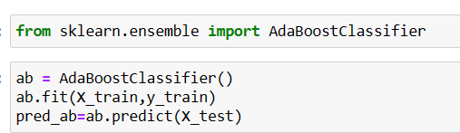
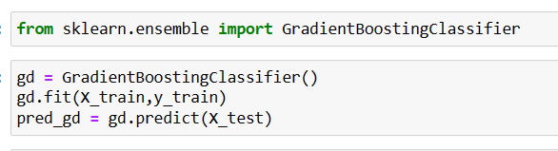
BOOSTING
AdaBoost
Gradient Boosting
Gradient Boosting combines several weak learners into strong learners, in which each new model is trained to minimize the loss function such as mean squared error or cross-entropy of the previous model using gradient descent.
In each iteration, the algorithm computes the gradient of the loss function with respect to the predictions of the current ensemble and then trains a new weak model to minimize this gradient.
The predictions of the new model are then added to the ensemble, and the process is repeated until a stopping criterion is met.
AdaBoost is a boosting algorithm that works on the principle of the stagewise addition method where multiple weak learners are used for getting strong learners.
It builds a model and gives equal weights to all the data points. It then assigns higher weights to points that are wrongly classified.
Now all the points with higher weights are given more importance in the next model. It will keep training models until and unless a lower error is received.

Slide 32
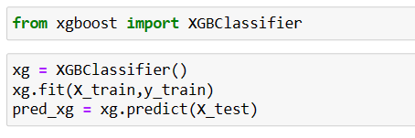
BOOSTING
XGBoost Machine
XGBoost stands for “Extreme Gradient Boosting”
It is widely used machine learning algorithms due to its ability to handle large datasets
Weights are assigned to all the independent variables which are then fed into the decision tree which predicts results.
The weight of variables predicted wrong by the tree is increased and these variables are then fed to the second decision tree.
These individual classifiers/predictors then ensemble to give a strong and more precise model.

Slide 33
MODEL EVALUATION
For model evaluation we use four evaluation metrics.
Accuracy:- It is simply the ratio of all correctly predicted cases whether positive or negative and all cases in the data. Accuracy = (TP+TN) / (TP+FP+FN+TN))
Precision:- It is the ratio of correctly predicted positive cases vs. all predicted positive cases. Precision = (TP / (TP + FP))
Recall:- Recall or sensitivity is the ratio of all correctly identified positive cases divided by all actually positive cases. Recall = (TP / (TP + FN))
F1-score:- The F1 Score is the weighted average of precision and recall, hence it takes both false positives and false negatives into account. F1-score = 2*TP/(2*TP+FP+FN)
Confusion Matrix:-
A confusion matrix is a table that is used to define the
performance of a classification algorithm.
The matrix displays the number of true positives (TP),
true negatives (TN),false positives (FP), and
false negatives (FN) produced by the model
on the test data.

Slide 34
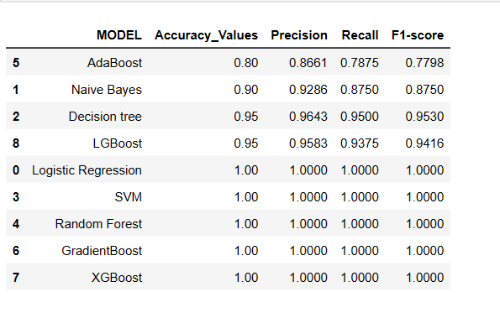
FINAL EVALAUATION METRICS AND CONCLUSIONS
Firstly we see whose accuracy values are Low, Excluding AdaBoost and Naïve bayes other models have high accuracy.
Then we see SVM, RF, GBM, XGBM, LR have 100% accuracy .
we consider Random Forest as our final model.
Taken Random Forest as Final Model

Slide 35
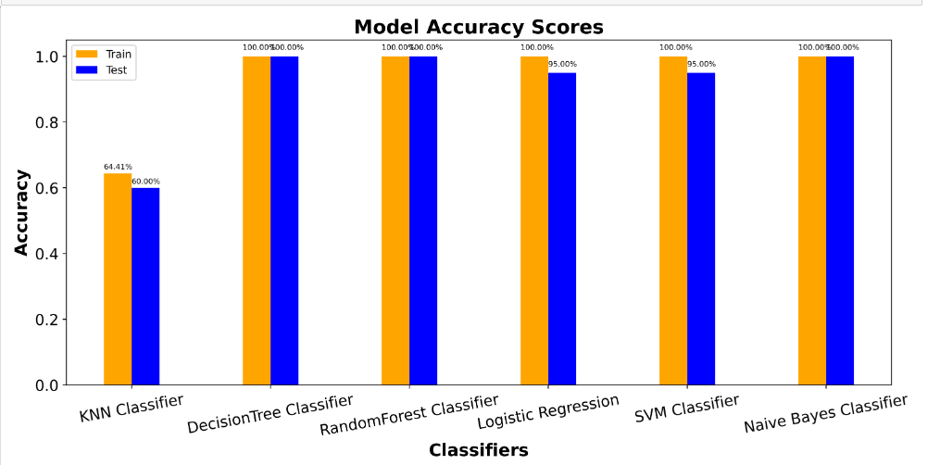
Model Accuracy Scores

Slide 36
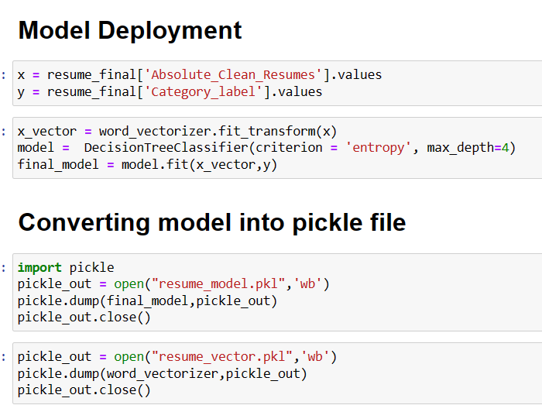
DEPLOYMENT
Firstly assign x and y variables.
Then vectorize the x variable.
Then fit the final model on x and y variable which is Random Forest Classifier model .
Convert the final model into a pickle file which is the process of converting a Python object into a byte stream to store it in a file/database, maintaining program state across sessions, or transport data over the network.
We also convert the vectorizer which is TF-IDF vector into a pickle file.

Slide 37
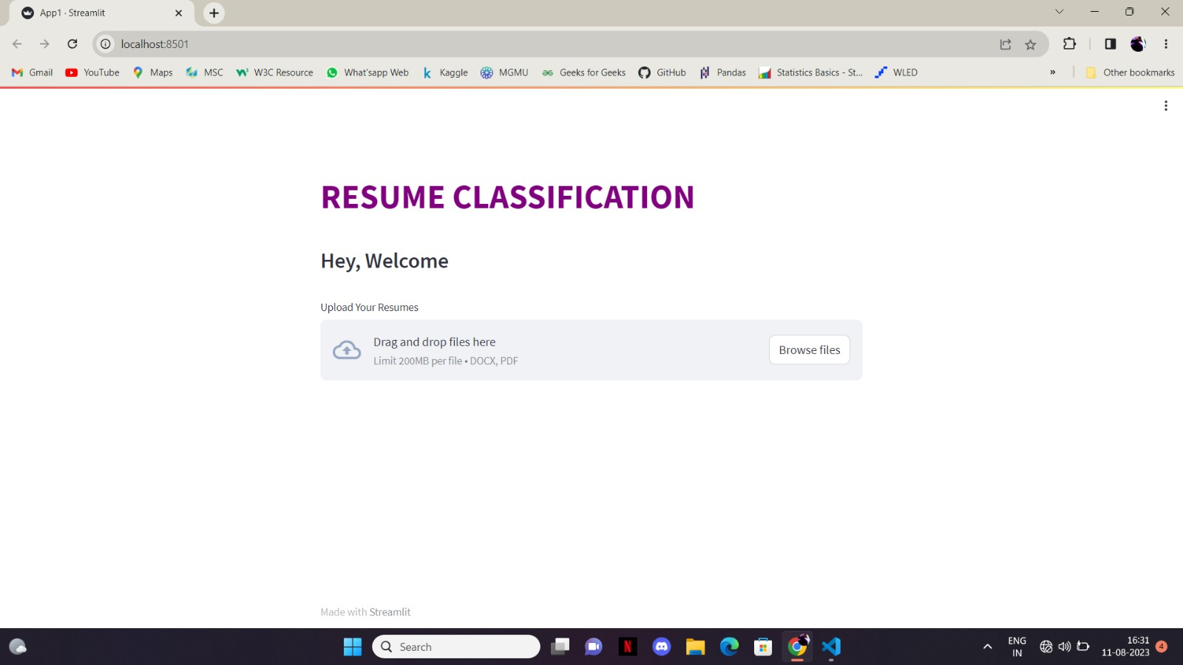
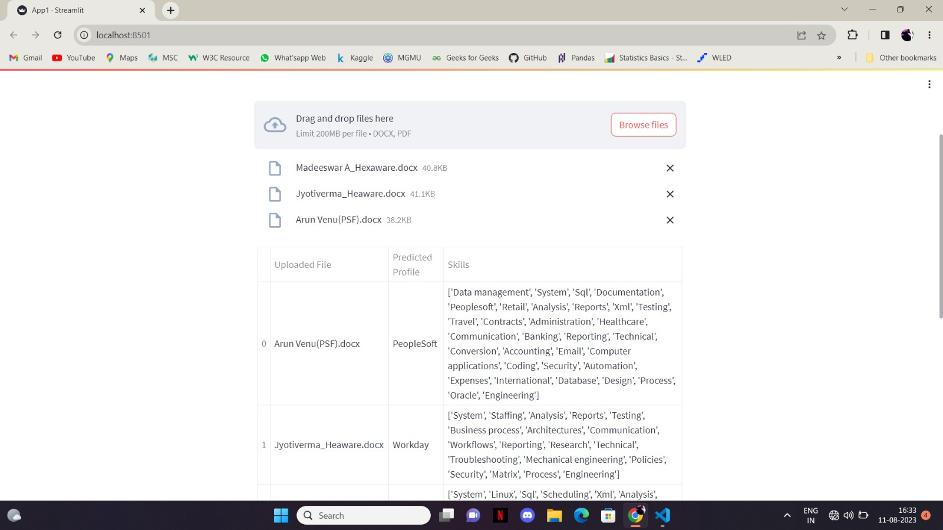
We run the .py file in command prompt using streamlit run filename.py command.
Then we see the file running as local host in the browser.
Here we select the files and then see the output.

Slide 38
Challenges :
Firstly the biggest challenge was Problem while downloading packages so we locally stored the packages.
Problem while installing the spacy and using it so we downgraded the version of spacy
Same issue with the en_core_web_sm
The problem of selection of files while in the deployment is running
Problem of processing the pkl file.

Slide 39
Future Scope
Recruitment: The most common application of resume classification is in the recruitment process, where it is used to screen resumes and identify the best candidates for the job. NLP can help match resumes to job descriptions and analyze them based on objective criteria, leading to better candidate selection outcomes.
Time and Cost Saving: Automating the resume screening process using NLP can save significant time and cost for employers, allowing them to focus on other important tasks.

Slide 40
Thank You

